Slide 1
Hooke-Jeeves method for finding extrema in n dimensions

Slide 2
Introduction
In this topic, we will
Describe the idea of exploring surrounding points
Use this exploration to indicate a direction to move
Describe the Hooke-Jeeves method
Discuss using this exploratory move/pattern move approach for solving problems in general
Look at an implemention
Look at an example

Slide 3
Definitions
Recall that in R^{n}, the canonical basis is represented by the vectors e₁, …, e_{n}
For e_{k}, all entries are zero except for the k^{th} entry which is one
For example, in R⁴, the canonical basis is

Slide 4
The Hooke-Jeeves method
Given a real-valued function of an n-dimensional vector variable, we will start with an initial guess u₀ and an initial step size h
The idea is we will make a local search to find a direction of greatest decrease, and then continue in that direction as far as possible

Slide 5
The Hooke-Jeeves method
The algorithm is as follows:
Given an approximation u_{k} and a current step size h
Let Δu_{k} ← 0
For j going from 1 to n,
Evaluate f_{–1} ← f (u_{k} + Δu_{k} – he_{j})
f₀ ← f (u_{k} + Δu_{k})
f₁ ← f (u_{k} + Δu_{k} + he_{j})
If f_{–1} < f₀, f₁, set Δu_{k} ← Δu_{k} – he_{j}
If f₁ < f₀, f_{–1}, set Δu_{k} ← Δu_{k} + he_{j}
If Δu_{k} = 0, if h is sufficient small, we are finished, otherwise, reduce h and return to the first step
Otherwise, evaluate f (u_{k} + mΔu_{k}) for successively larger integer values of m until f (u_{k} + mΔu_{k}) < f (u_{k} + (m + 1)Δu_{k})
Set u_{k+1} ← u_{k} + mΔu_{k} and return to the first step

Slide 6
The Hooke-Jeeves method
To summarize the strategy:
Explore the points around u_{k} and find the Δu_{k} that offers the best move towards the minimum
These are called exploratory moves
If no better point was found, either we are finished, or we try again in a smaller neighborhood
If a better point is found, continue moving in the direction indicated by this Δu_{k} until we find a minimum in that direction
These are called pattern moves

Slide 7
Problem-solving techniques
This problem-solving strategy can be used for other searches:
In a process of exploration, determine a local improvement
If an improvement is found, use this pattern to move towards a better solution
If no improvement is found,
Either declare the current approximation to be acceptable,
Or try again with different searching criteria

Slide 8
Implementation
std::pair<vector, double>
hooke_jeeves( double f( vector u ), vector u, double h, double eps_step, double eps_abs, unsigned int max_iterations ) {
unsigned int dim{ u.dim() };
double min{ f( u ) };
for ( unsigned int k{0}; k < max_iterations; ++k ) {
// Exploratory moves
// Check conditions
// Pattern moves
}
return std::make_pair( vector{ dim, 0.0 }, NAN );
}

Slide 9
Implementation
// Exploratory moves
vector u0{ u };
double min0{ min };
vector du{ vector{ dim, 0.0 } }; // The n-dimensional zero vector
for ( unsigned int j{0}; j < dim; ++j ) {
du( j ) = -h;
double fn{ f( u + du ) };
du( j ) = h;
double fp{ f( u + du ) };
if ( (fp < fn) && (fp < min) ) {
min = fp;
} else if ( fn < min ) {
du( j ) = -h;
min = fn;
} else {
du( j ) = 0.0;
}
}
u += du;

Slide 10
Implementation
// Check conditions
if ( norm( du ) == 0.0 ) {
if ( h < eps_step ) {
return std::make_pair( u, min );
} else {
h /= 2.0;
continue;
}
}

Slide 11
Implementation
// Pattern moves
// - We stored the initial values in u0 and min0
while ( k < max_iterations ) {
double fm{ f( u + du ) };
++k;
if ( fm < min ) {
u += du;
min = fm;
} else {
break;
}
}
if ( (k < max_iterations) && (norm( u - u0 ) < eps_step)
&& ((min0 - min) < eps_abs) ) {
return std::make_pair( u, min );
}

Slide 12
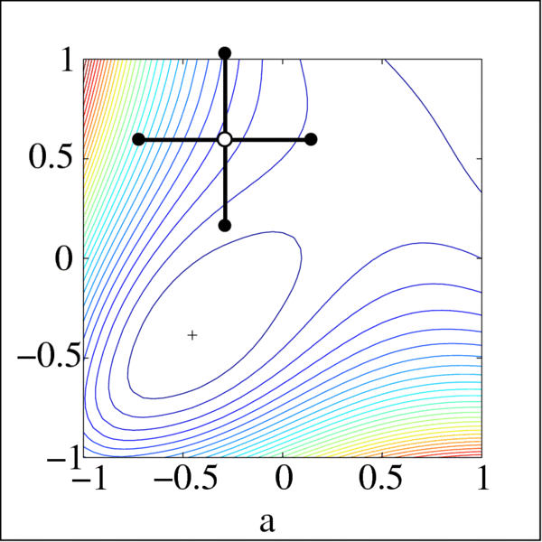
Example
The example on the Wikipedia page is most appropriate
Created by Guillaume Jacquenot

Slide 13
Summary
Following this topic, you now
Understand the Hooke-Jeeves method for finding a minimum
Are aware of this exploratory/pattern approach to solving problems
Have seen an implementation
Have seen an example

Slide 14
References
[1] https://en.wikipedia.org/wiki/Pattern_search_(optimization)

Slide 15
Acknowledgments
None so far.

Slide 16
Colophon
These slides were prepared using the Cambria typeface. Mathematical equations use Times New Roman, and source code is presented using Consolas. Mathematical equations are prepared in MathType by Design Science, Inc.
Examples may be formulated and checked using Maple by Maplesoft, Inc.
The photographs of flowers and a monarch butter appearing on the title slide and accenting the top of each other slide were taken at the Royal Botanical Gardens in October of 2017 by Douglas Wilhelm Harder. Please see
https://www.rbg.ca/
for more information.

Slide 17
Disclaimer
These slides are provided for the ece 204 Numerical methods course taught at the University of Waterloo. The material in it reflects the author’s best judgment in light of the information available to them at the time of preparation. Any reliance on these course slides by any party for any other purpose are the responsibility of such parties. The authors accept no responsibility for damages, if any, suffered by any party as a result of decisions made or actions based on these course slides for any other purpose than that for which it was intended.

